Slide 1
CND111: FPGA Flow

Slide 2
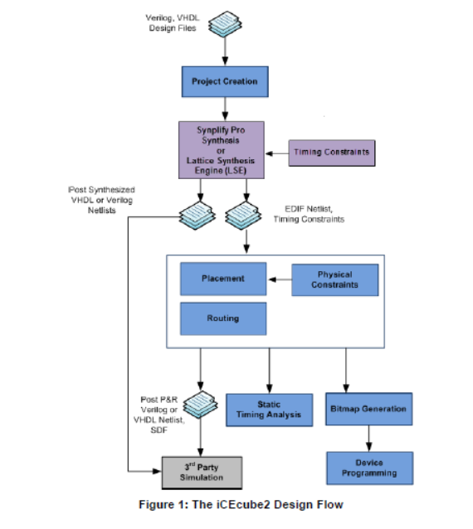
IceCube Design Flow
SDF stands for Standard delay format.
It gives information on the timing data extensively used in backend VLSI design flows.
SDF gives information about
Path delays
Interconnect delays
Timing constraints
Tech parameters affecting delays
Cell delays

Slide 3
Number of CLK Cycles to represent delay
FPGA CLK frequency is 12MHZ which means that its period is 8.333e-8 sec
If we toggle the LED at each edge, then it appears on all the time as the clock is very fast
To make the LED toggle each 1 sec, then we need to determine the appropriate number of clock cycles to toggle after them, so, we need a counter to count the number of edges that makes a delay of 1 sec
Delay time = CLK period * CLK cycles
1 sec = 8.333e-8 * CLK cycles
CLK cycles = 12,000,000 (12M)
Then we take an action every 12M clock cycle to represent a delay 1 sec between any 2 consecutive actions to can see the actions clearly with our eyes.

Slide 4
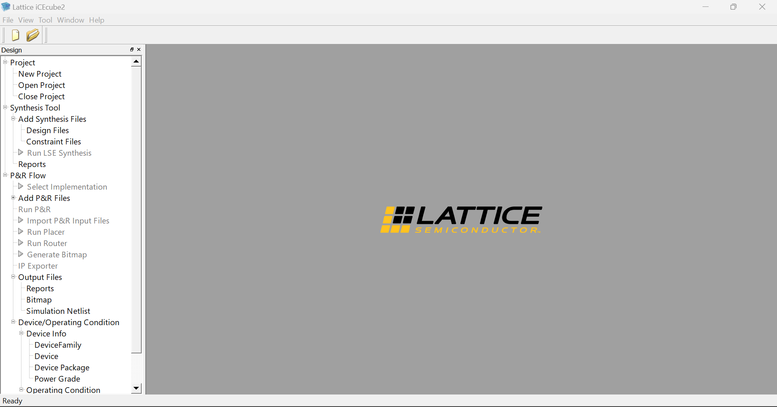
Steps to use iCEcube2
Double click on New Project

Slide 5
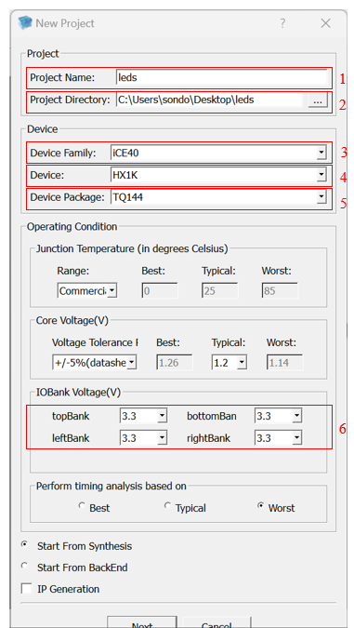
Steps to use iCEcube2
Fill the fields inside the red rectangles. Make sure that fields 3,4,5 and 6 are as shown in the figure.
don’t forget to create a folder to contain your project then put the path of the folder in the Project Directory field.
3. Then click Next.

Slide 6
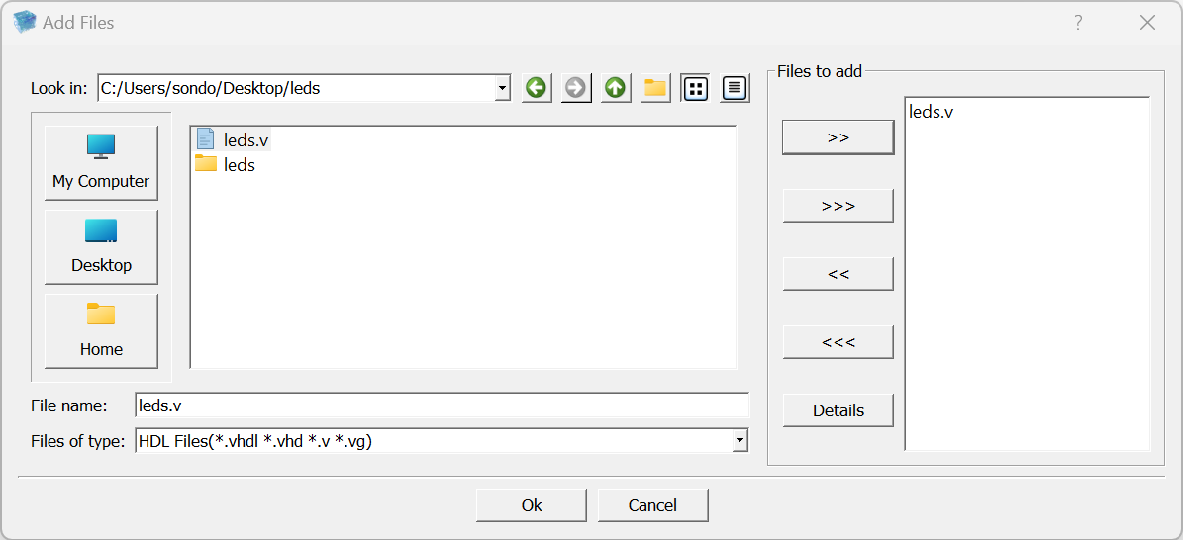
Steps to use iCEcube2
Browse to the Verilog file that contains the design, then select it and click on >> arrow to add it to Files to add list. Then click Ok.

Slide 7
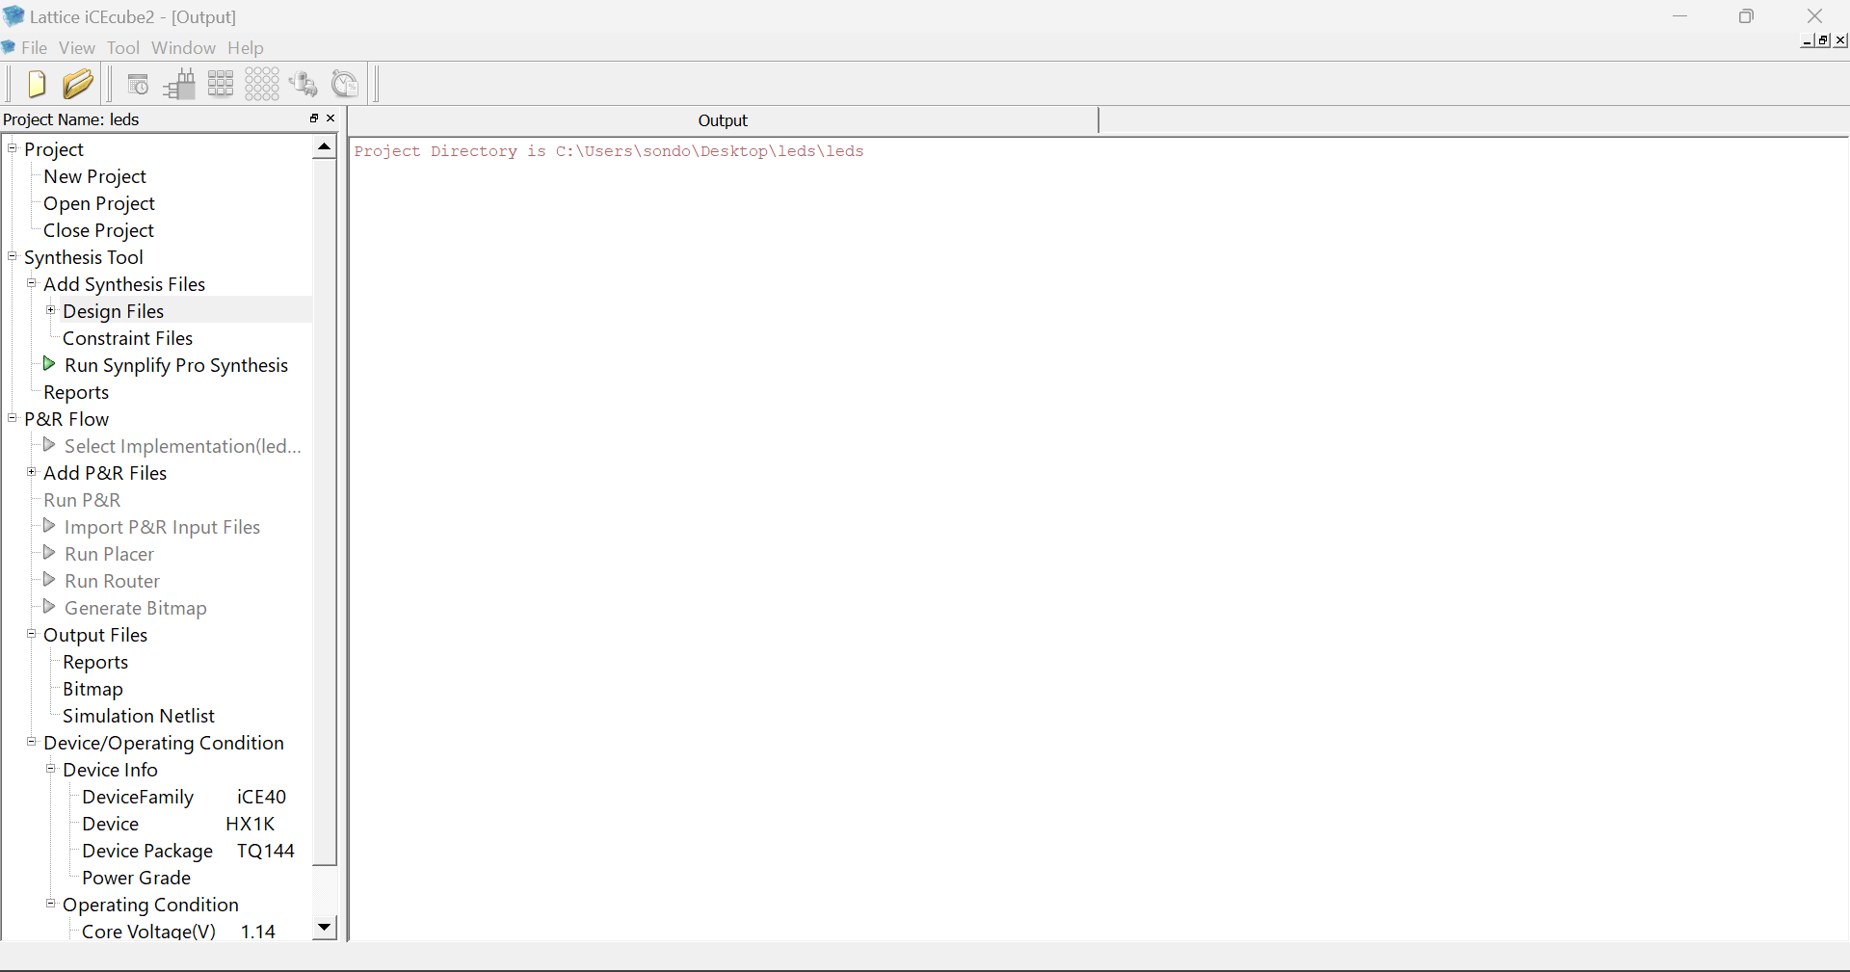
Steps to use iCEcube2
Double click on Run Synplify Pro Synthesis

Slide 8
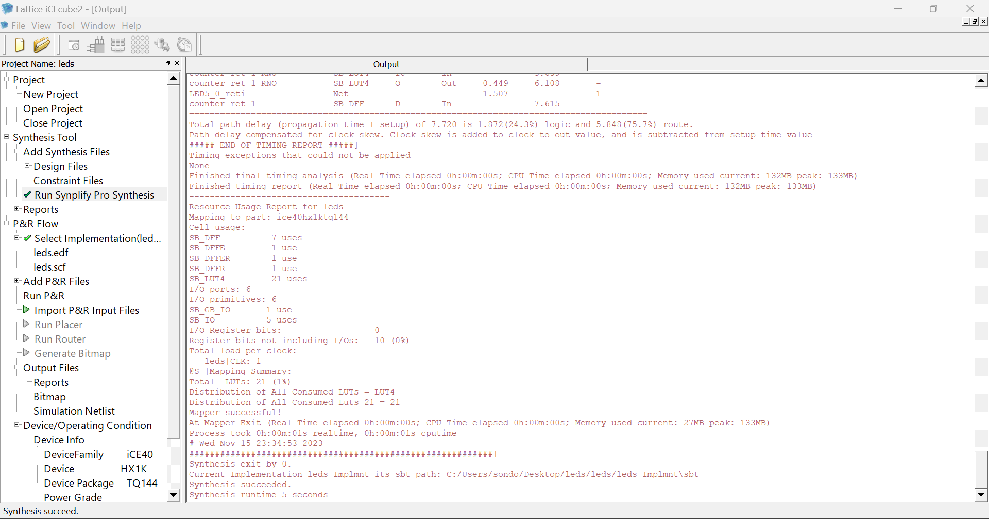
Steps to use iCEcube2
Double click on Import P&R Input Files

Slide 9
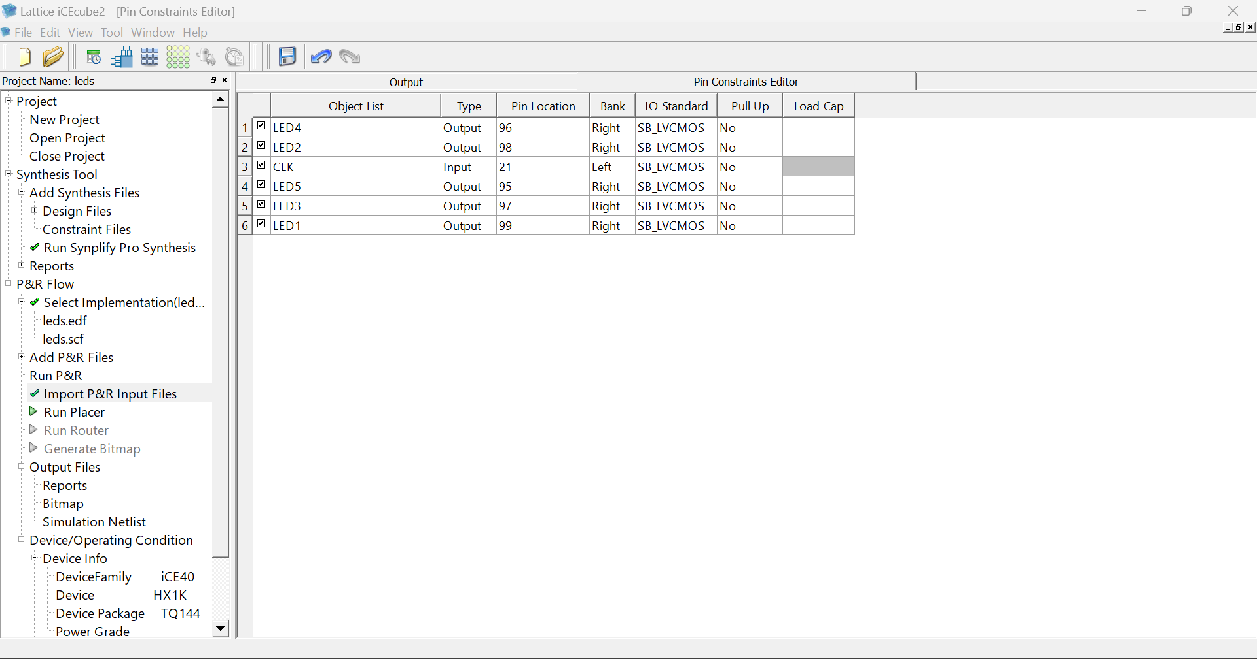
Steps to use iCEcube2
1- Click on Pin Constraints Editor icon
2- Pin Constraints Editor tap is opened
3- Fill the Pin Location and IO Standard and Pull Up columns
Note: Bank column is filled automatically while you are filling the Pin Location column
Note: Pin Location numbers of LEDs and clock are got from datasheet of the FPGA board.

Slide 10
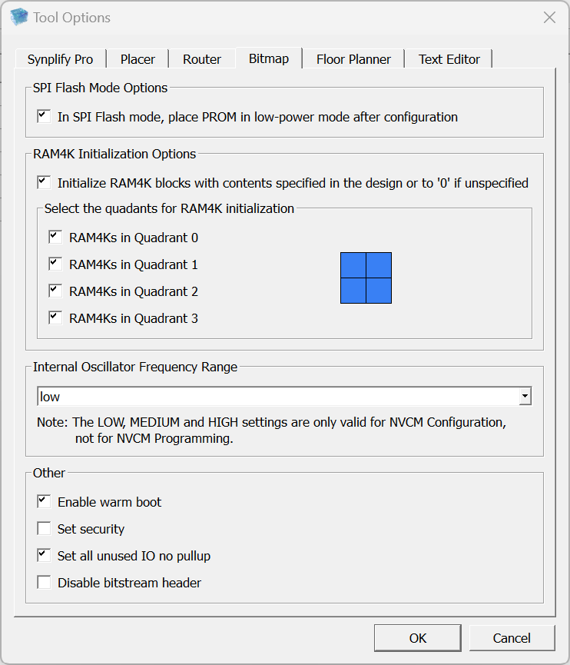
Steps to use iCEcube2
1- Click on Tool menu then Tool Options
2- Choose Bitmap tap and check the box behind Set all unused IO no pullup then click Ok.

Slide 11
Steps to use iCEcube2
Double click on Run P&R

Slide 12
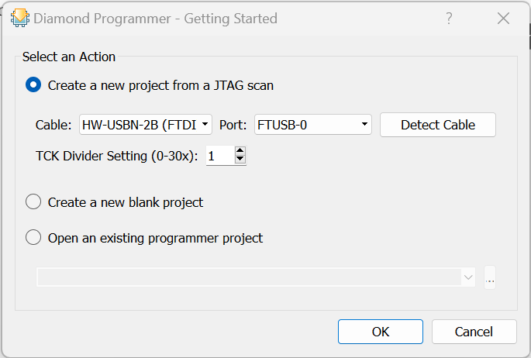
Steps to use Diamond Programmer
Click Ok

Slide 13
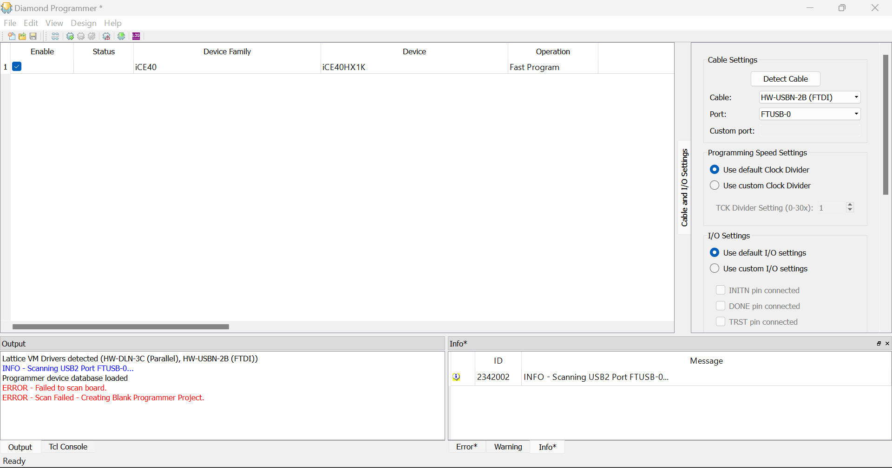
Steps to use Diamond Programmer
Double click on Device family and Device then choose from the menu the selected choices (iCE40 – iCE40HX1K)

Slide 14
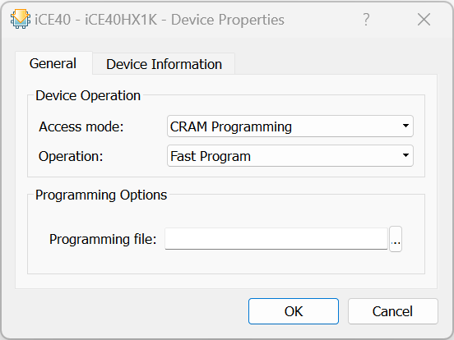
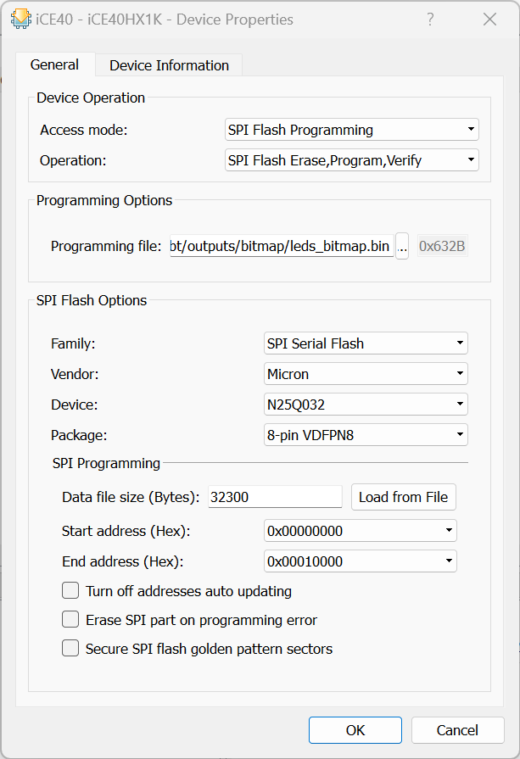
Steps to use Diamond Programmer
Double click on Operation, the following window is opened:
2. Choose Access mode to be SPI Flash Programming and the window is stretched as the following:
Make sure that the settings are as seen in the figure.
In Programming file field, browse for the .bin file. The .bin file is found in the following path: C:/Users/sondo/Desktop/leds/leds/leds_Implmnt/sbt/outputs/bitmap/leds_bitmap.bin
Then click Ok.

Slide 15
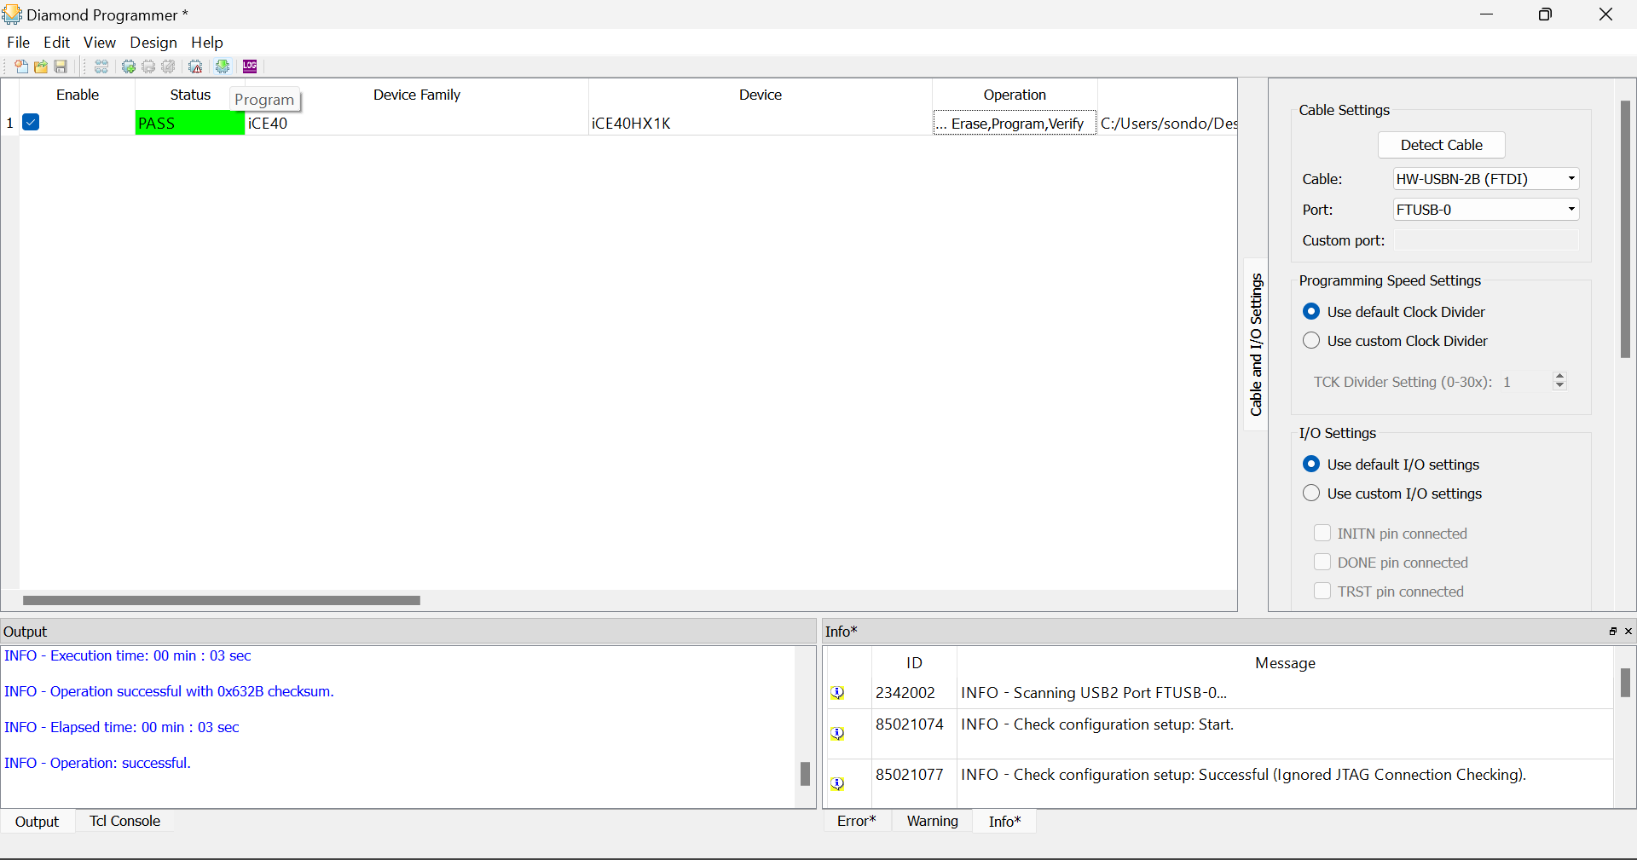
Steps to use Diamond Programmer
Click on Program icon to start programming and uploading the file into the memory. After finishing, you will find the LEDs on the board are blinking in a certain pattern according to the code.

Slide 16
Reports

Slide 17
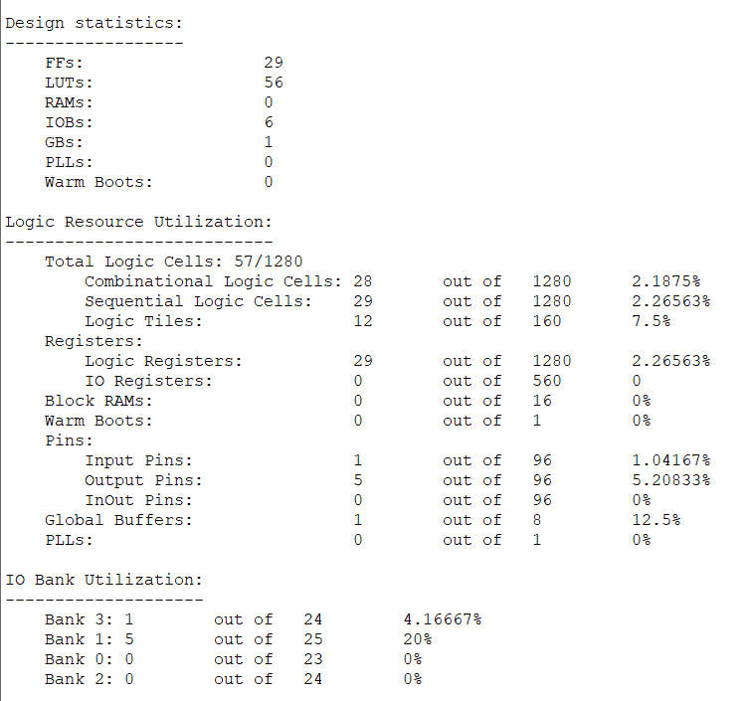
Resource Utilization Report:
Tool >> View Report

Slide 18
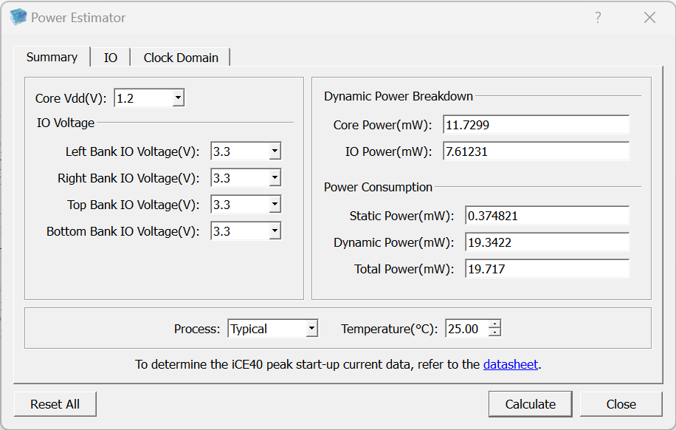
Power Report:
Tool >> Power Estimator
Core Power: is the power dissipated during charging and discharging the capacitors in internal nodes.
IO Power: is the power dissipated during charging and discharging the external load capacitors connected to device pins.
Process and Temperature affects Static Power only while IO Voltage affects both Static (small change) and Dynamic (large change)

Slide 19
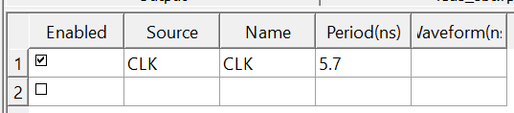
Timing Report:
Tool >> Timing Analysis >> Clock Summary
Tool >> Timing Constraints Editor -------- > to add constraints on the clock (increase the actual frequency)
Save the .sdc file

Slide 20
Timing Report:
Tool >> Run All
Tool >> Timing Analysis >> Clock Summary
Try to make the Target Frequency which is the actual frequency to be equal to or less than FMAX frequency to solve the setup violation (make the worst slack positive).

